Slide 1
Robust s. team

Slide 2
About our team
Our team is working together for almost 3 years and we are good friends we have been learned everything by ownselfs about robotics and phisics

Slide 3
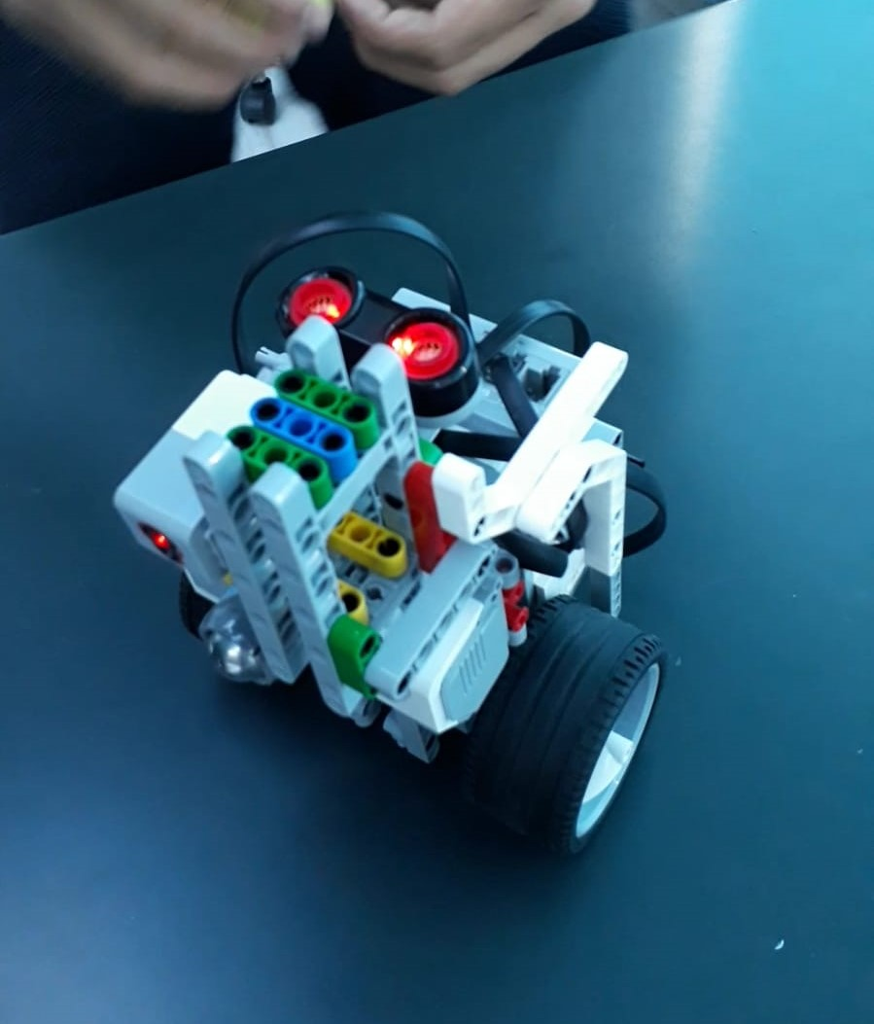
startıng
Robot is starting upright and falling fully otomaticly with motors. And with this way it can be bigger.

Slide 4
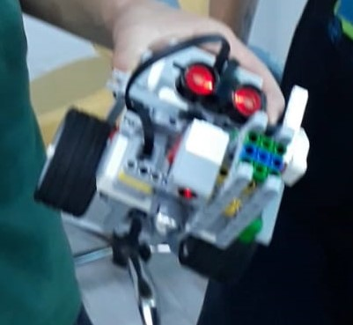
scannıng
Our robot is spinning 360 degrees for seeing enemy robot. And it scans with its ultrasonic sensor.

Slide 5
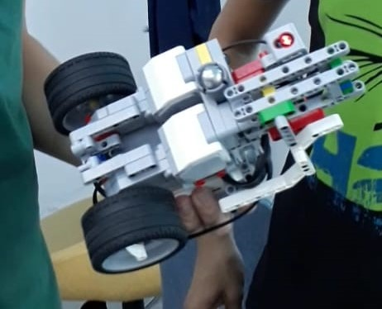
Goıng forward for pushıng
When robot see something in area, robot going directly, and when arena is over it can see whit its color sensor and going backward for scan again.

Slide 6
SEE YOU IN ST. PETERSBUTGE
WE ARE THE ROBUST S., AND WE ARE COMING FOR GLORY.

