Slide 1
CROLine

Slide 2
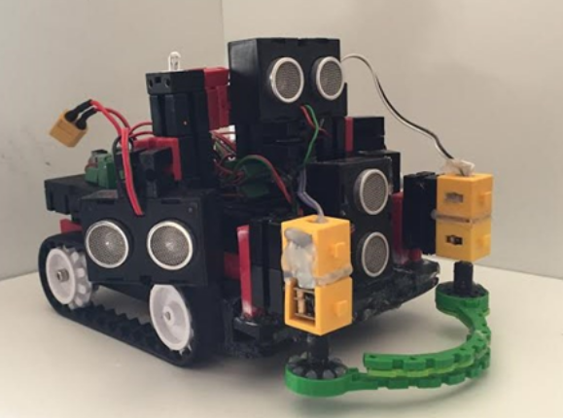
Our Robot
2.
3.
4.
1.
1. 5 IR Sensors
2. 4 Ultrasonic Sensors
3. TX Controller
4. Victim picking arms

Slide 3
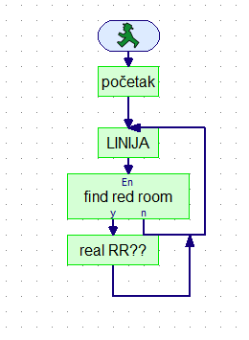
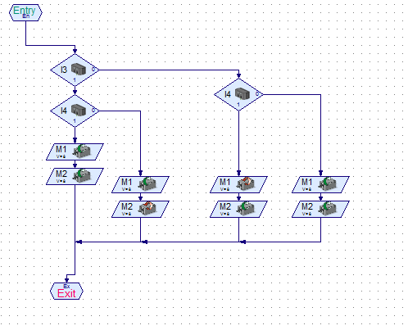
The program
Main program
Line following

Slide 4
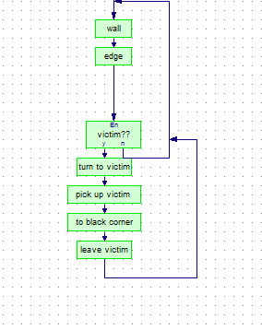
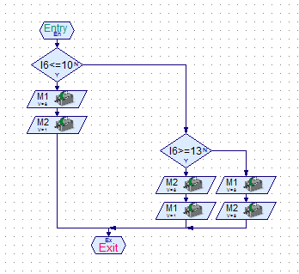
Red room
Wall following

